Slide 1
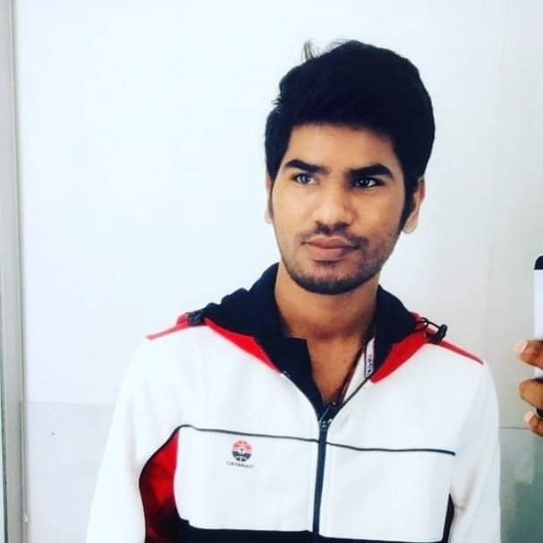
Relevant Experience:
An integrated release and deployment strategy that composes and orchestrates different DevOps tools in tandem to achieve seamless deployments.
Accelerator : Devops Stack on Slack
Worked on development and deployment of a web application using spring mvc and hibernate(without angular).
Deploy applications using DevOps concepts like configuration management and continuous deployment using ansible and Jenkins and even worked on tools like Sonarqube, Snyk, Zabbix, Trufflehog, Slack.
As part of an accelerator integrated tools like Jenkins, Sonarqube, Jfrog, Snyk with Slack.
Project : SRE Observability Dashboards
Installation and setup of ELK and EFK stack for getting various logs onto Kibana Dashboards.
Different types of logs including syslogs, Kubernetes node and pod logs, application logs, apache logs, nginx logs etc.
As part of an accelerator, Deployment of an application withput and with database inside a kubernetes cluster
Worked on Application Performance Management (APM) to get the detailed metrics of an application as well as it’s correlated database metrics in view of transactions, spans, errors, tasks etc.
Worked on Prometheus AlertManager by creating some custom alert-rules.
Configured Alertmanager with email, slack, pagerduty to get the alert notifications as well as able to notify the both slack and pagerduty at once by integrating them.
Certifications
AZ-104 Microsoft Azure Administrator. Date of certification: 17-09-2020
AZ-900: Microsoft Azure Fundamentals. . Date of certification: 02-07-2020
Bhaskar Reddy G
Devops Engineer
Skills Summary:
Cloud technologies – Azure, Aws
Configuration management – Ansible
Continuous Integration –Jenkins, SonarQube,
Jfrog artifactory.
Containerization – Docker,Docker Compose
Infrastructure Automation - Terraform
Security Management - Snyk,Trufflehog
Linux and Shell Scripting
Education:
Bachelor of Engineering in Electrical and Electronics Engineering, RGMCET (2015-2019), Nandyal,AndhraPradesh.
Experience:
Devops Engineer with almost 1 year of experience in latest Cloud technologies and CI/CD tools.
Strengths:
Highly interested in learning new technologies as well as implementing them in the
work place scenario.
Able to quickly learn new concepts and understand the domain.
Hands on Experience on various tools like Prometheus, Elasctic Logstash Kibana (ELK), Elastic Fluentd Kibana (EFK) stacks.
Hands on Experience in deployment of an applicatiom inside a k8 cluster.
Can create an CI/CD pipelines and will integrate it to various tools like Jfrog, Sonarqube and will deploy it by using Docker or Ansible in Jenkins.
Slide 1

